Slide 1
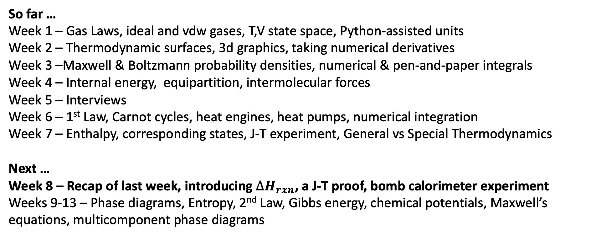
Retrospective and prospective
So far …
Week 1 – Gas Laws, ideal and vdw gases, T,V state space, Python-assisted units
Week 2 – Thermodynamic surfaces, 3d graphics, taking numerical derivatives
Week 3 –Maxwell & Boltzmann probability densities, numerical & pen-and-paper integrals
Week 4 – Internal energy, equipartition, intermolecular forces
Week 5 – Interviews
Week 6 – 1st Law, Carnot cycles, heat engines, heat pumps, numerical integration
Week 7 – Enthalpy, corresponding states, J-T experiment, General vs Special Thermodynamics
Next …
Week 8 – Recap of last week, introducing $∆H_{rxn}$, a J-T proof, bomb calorimeter experiment
Weeks 9-13 – Phase diagrams, Entropy, 2nd Law, Gibbs energy, chemical potentials, Maxwell’s equations, multicomponent phase diagrams

Slide 2
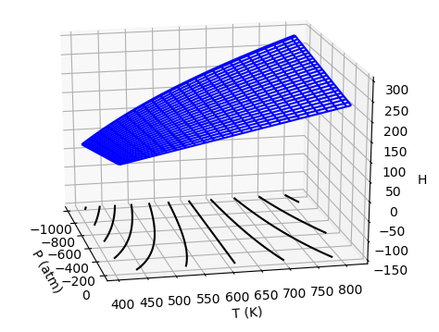
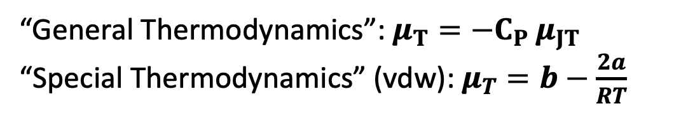


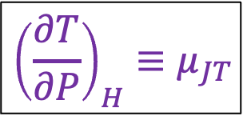
Recap: The isothermal Joule-Thomson coefficient $μ_{T}$
$$C_{P}$$
$$μ_{T}$$
$${{\left(\frac{∂T}{∂P}\right)}_{H}≡μ}_{JT}$$
“General Thermodynamics”: $μ_{T}=−C_{P} μ_{JT}$
“Special Thermodynamics” (vdw): $μ_{T}=b−\frac{2a}{RT}$

Slide 3
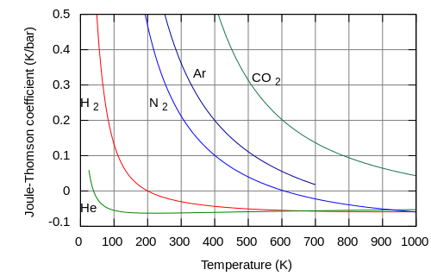
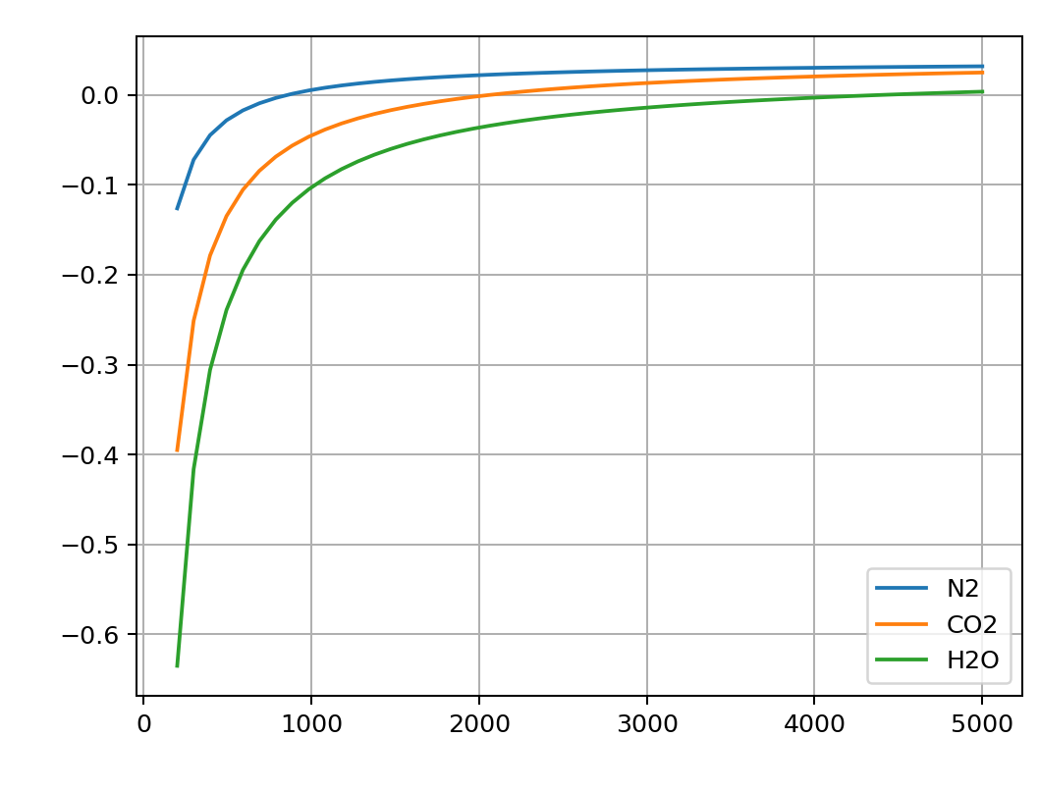
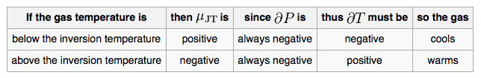
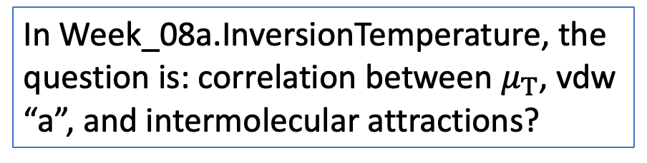
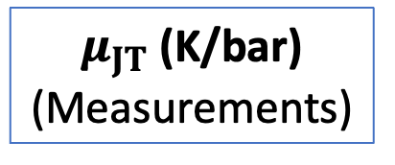

Recap: Temperature dependence of $μ_{JT}$ and $μ_{T}$
$μ_{JT}$ (K/bar)
(Measurements)
$$μ_{T}$$
In Week_08a.InversionTemperature, the question is: correlation between $μ_{T}$, vdw “a”, and intermolecular attractions?

Slide 4
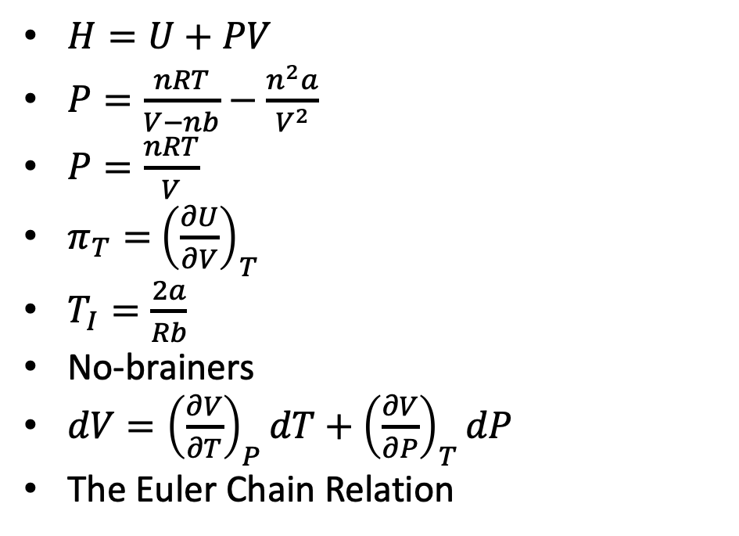
Recap: More “General Thermodynamics” vs “Special Thermodynamics”
It’s useful to think about all the equations we’ve worked with so far as being General or Special. Can you do that sorting?
$H=U+PV$
$P=\frac{nRT}{V−nb}−\frac{n^{2}a}{V^{2}}$
$P=\frac{nRT}{V}$
$π_{T}=$ ${\left(\frac{∂U}{∂V}\right)}_{T}$
$T_{I}=\frac{2a}{Rb}$
No-brainers
$dV={\left(\frac{∂V}{∂T}\right)}_{P}dT+{\left(\frac{∂V}{∂P}\right)}_{T}dP$
The Euler Chain Relation

Slide 5
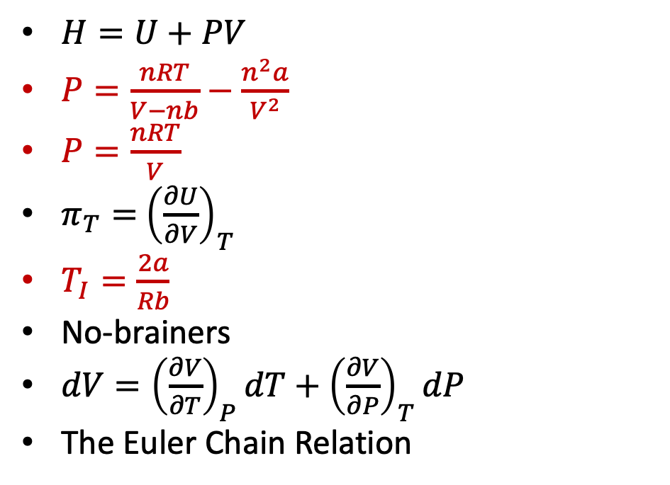
Recap: More “General Thermodynamics” vs “Special Thermodynamics”
It’s useful to think about all the equations we’ve worked with so far as being General or Special. Can you do that sorting?
$H=U+PV$
$P=\frac{nRT}{V−nb}−\frac{n^{2}a}{V^{2}}$
$P=\frac{nRT}{V}$
$π_{T}=$ ${\left(\frac{∂U}{∂V}\right)}_{T}$
$T_{I}=\frac{2a}{Rb}$
No-brainers
$dV={\left(\frac{∂V}{∂T}\right)}_{P}dT+{\left(\frac{∂V}{∂P}\right)}_{T}dP$
The Euler Chain Relation

Slide 6
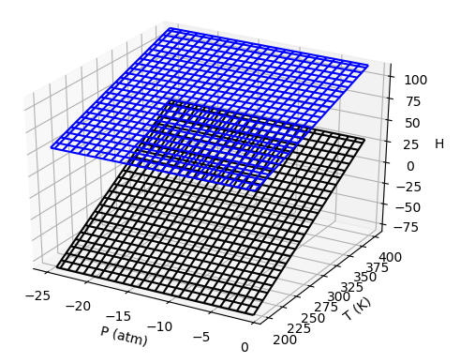

$∆H_{rxn}$ from the perspective of thermodynamic surfaces
vapor
$$∆H_{vap}$$
liquid
$∆H_{rxn}$is a generic term for any physical or chemical transformation. Here, the “reaction” is vaporization, so $∆H_{rxn}$ = $∆H_{vap}$.

Slide 7
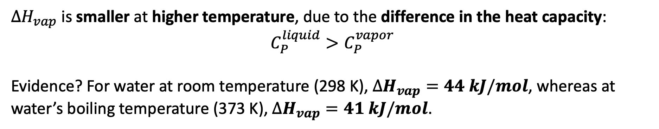
$∆H_{rxn}$ trends as we cruise through state space
vapor
$$∆H_{vap}$$
liquid
$∆H_{vap}$ is smaller at higher temperature, due to the difference in the heat capacity:
$$C_{P}^{liquid}>C_{P}^{vapor}$$
Evidence? For water at room temperature (298 K), $∆H_{vap}=44 kJ/mol$, whereas at water’s boiling temperature (373 K), $∆H_{vap}=41 kJ/mol$.

Slide 8
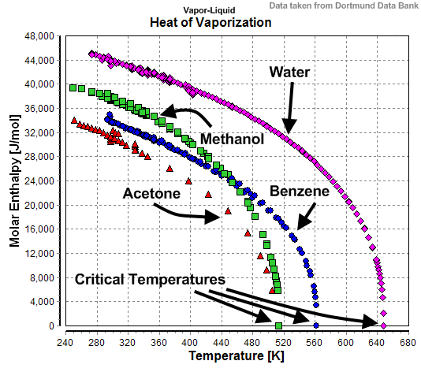
$∆H_{rxn}$ trends as we cruise through state space
vapor
$$∆H_{vap}$$
liquid
$∆H_{vap}$ -> 0 as one approaches the critical temperature

Slide 9
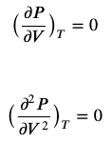




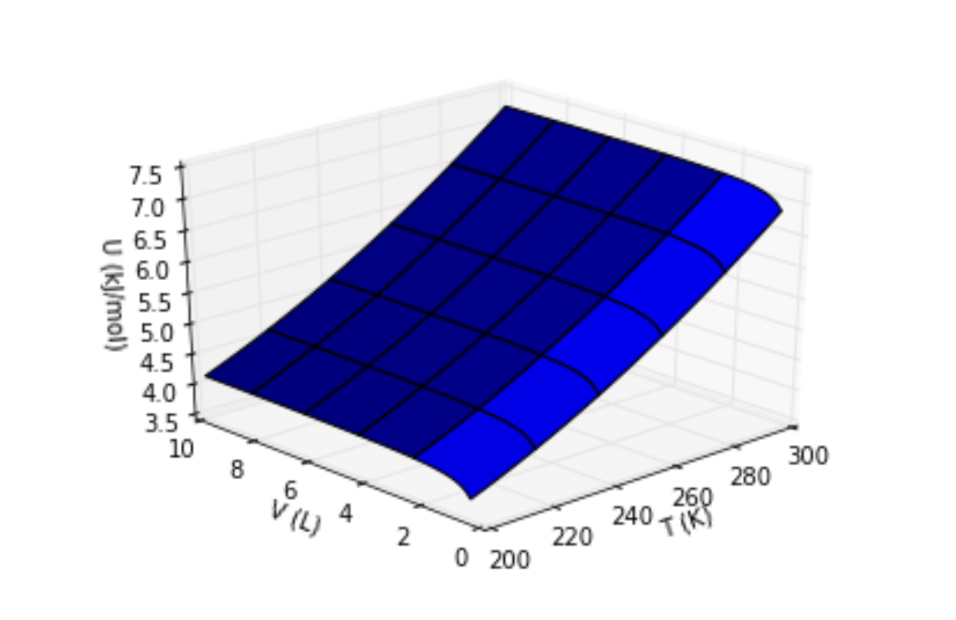
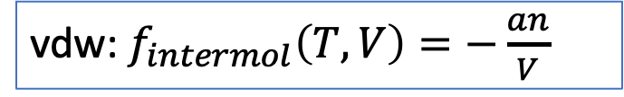
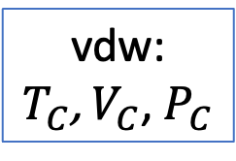

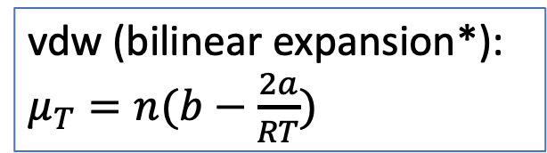
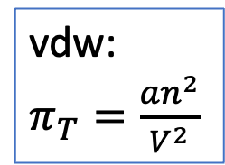
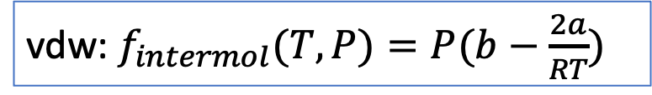
There’s a piece of the roadmap we haven’t done yet
AnalyticalTcrit (diff calculus)
vdw:
$T_{C}$, $V_{C}$, $P_{C}$
$P=P(T,V)$
AnalyticalMuT & The Box
vdw:
$π_{T}=\frac{an^{2}}{V^{2}}$
vdw (bilinear expansion*): $μ_{T}=n(b−\frac{2a}{RT})$
AnalyticalUH (integral calculus)
vdw: $f_{intermol}\left(T,V\right)=−\frac{an}{V}$
vdw: $f_{intermol}(T,P)=P(b−\frac{2a}{RT})$
VisualizingU
VisualizingH

Slide 10
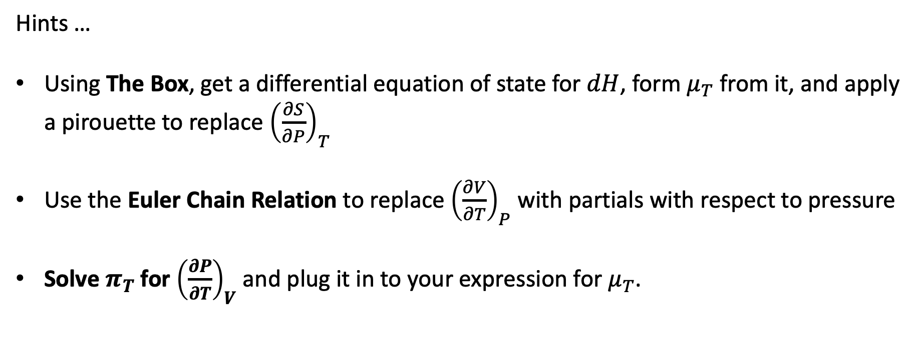

Deriving $μ_{T}=\frac{P+π_{T}}{{\left(\frac{∂P}{∂V}\right)}_{T}}+V$
Hints …
Using The Box, get a differential equation of state for $dH$, form $μ_{T}$ from it, and apply a pirouette to replace ${\left(\frac{∂S}{∂P}\right)}_{T}$
Use the Euler Chain Relation to replace ${\left(\frac{∂V}{∂T}\right)}_{P}$ with partials with respect to pressure
Solve $π_{T}$ for ${\left(\frac{∂P}{∂T}\right)}_{V}$ and plug it in to your expression for $μ_{T}$.

